Slide 1
Hydraulic Servo and Related Systems
ME4803 Motion Control
Wayne J. Book
HUSCO/Ramirez Chair in Fluid Power and Motion Control
G.W. Woodruff School of Mechanical Engineering
Georgia Institute of Technology

Slide 2

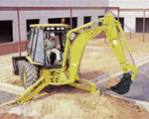

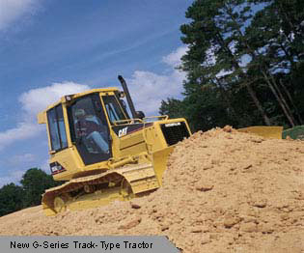
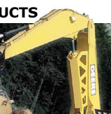
Hydraulics is Especially critical to the Mobile Equipment Industry

Slide 3
References
Norvelle, F.D. Fluid Power Control Systems, Prentice Hall, 2000.
Fitch, E.C. and Hong I.T. Hydraulic Component Design and Selection, BarDyne, Stillwater, OK, 2001.
Cundiff, J.S. Fluid Power Circuits and Controls, CRC Press, Boca Raton, FL, 2002.
Merritt, H.E. Hydraulic Control Systems, John Wiley and Sons, New York, 1967.
Fluid Power Design Engineers Handbook, Parker Hannifin Company (various editions).

Slide 4
The Strengths of Fluid Power
(Hydraulic, to a lesser extent pneumatic)
High force at moderate speed
High power density at point of action
  Fluid removes waste heat
  Prime mover is removed from point of action
  Conditioned power can be routed in flexible a fashion
Potentially “Stiff” position control
Controllable either electrically or manually
  Resulting high bandwidth motion control at high forces
NO SUBSTITUTE FOR MANY HEAVY APPLICATIONS

Slide 5
Difficulties with Fluid Power
Possible leakage
Noise generated by pumps and transmitted by lines
Energy loss due to fluid flows
Expensive in some applications
Susceptibility of working fluid to contamination
Lack of understanding of recently graduated practicing engineers
  Multidisciplinary
  Cost of laboratories
  Displaced in curriculum by more recent technologies

Slide 6
System Overview
Volts-amp
Electric or IC prime mover
Transmission line & valve
Rpm-torque
Flow-press.
Flow-press.
Motor or cylinder
Rpm-torque or force
Pump
Coupling mechanism
The system consists of a series of transformation of power variables
Power is either converted to another useful form or waste heat
Impedance is modified (unit force/unit flow)
Power is controlled
Function is achieved
Rpm-torque or force
Load

Slide 7
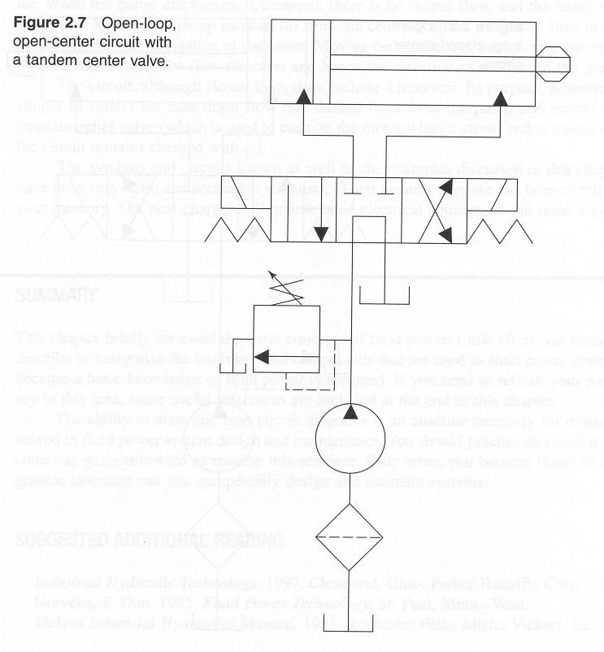
Simple open-loop open-center circuit
cylinder
Actuating solenoid
Spring return
Pressure relief valve
4-way, 3 position valve
filter
Fixed displacement pump
Fluid tank or reservoir

Slide 8
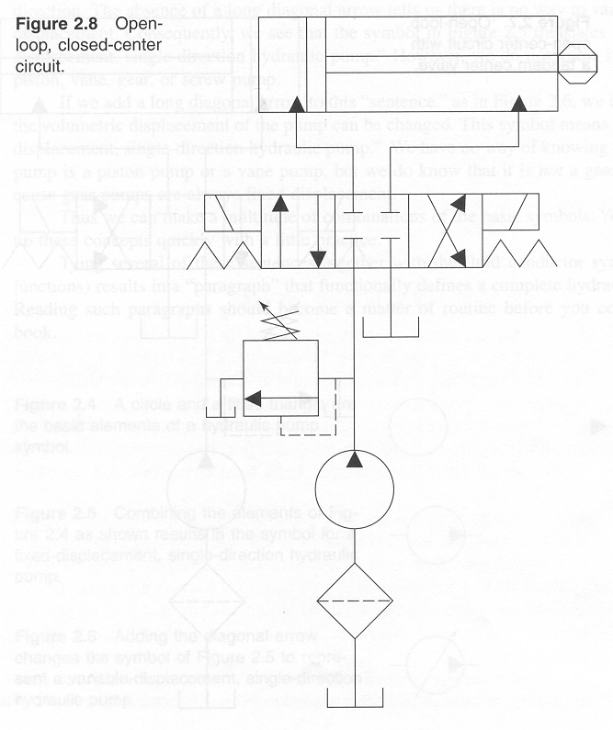
Simple open-loop closed-center circuit

Slide 9
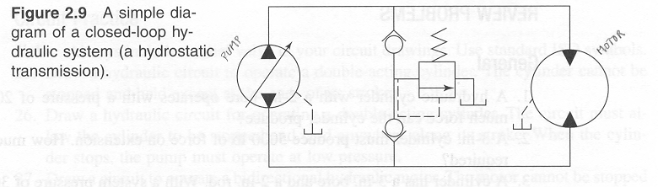
Closed-loop (hydrostatic) system
Motor
Check valve
Variable displacement reversible pump
Drain or auxiliary line

Slide 10
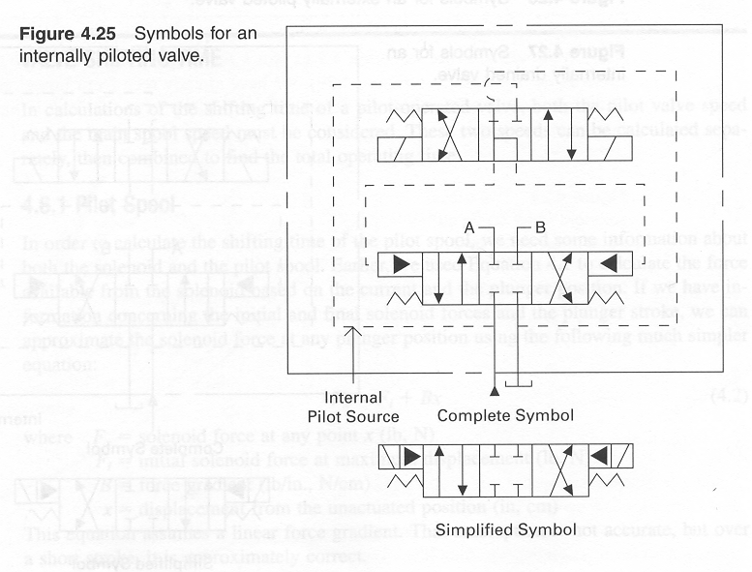
Pilot operated valve

Slide 11
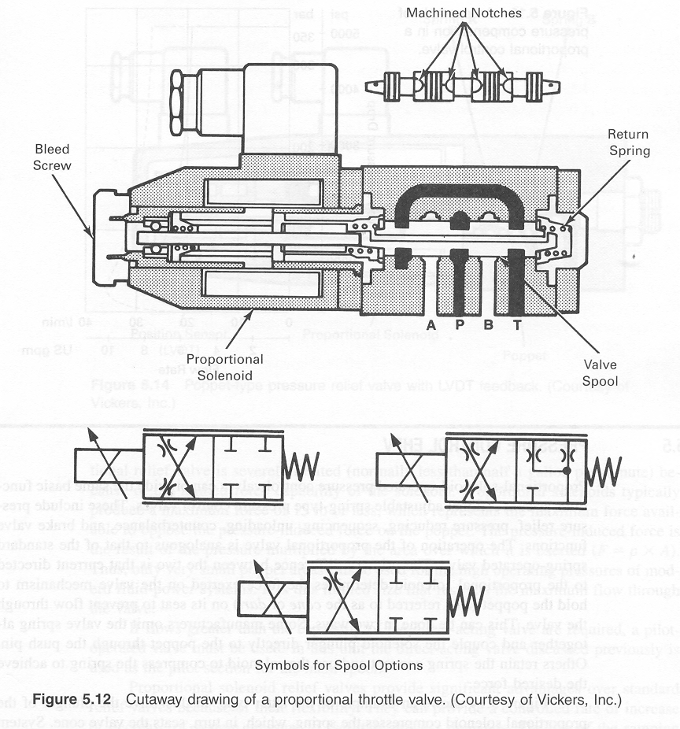
Proportional Valve

Slide 12
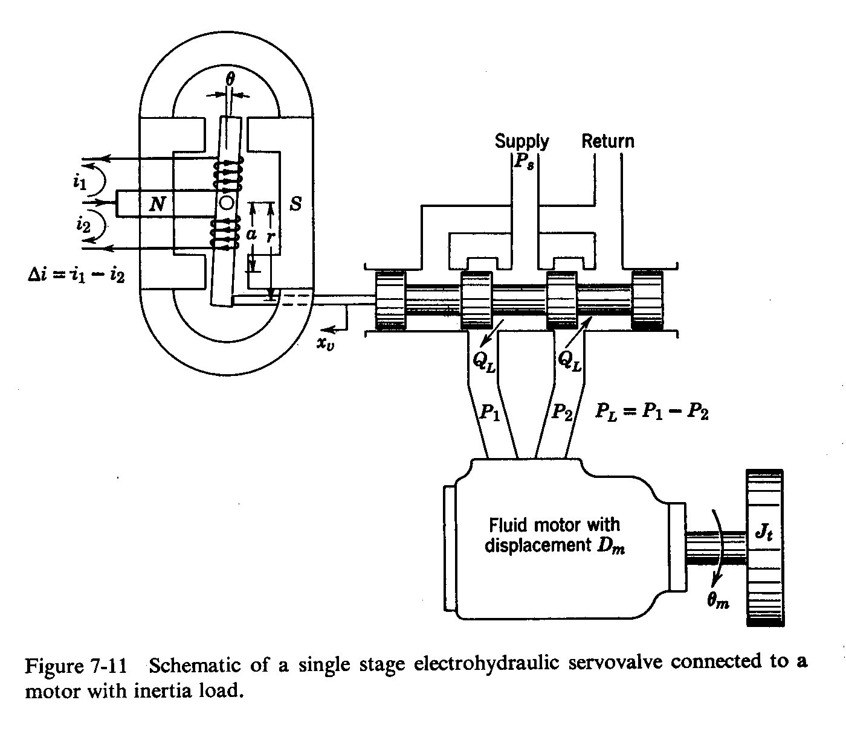
Basic Operation of the Servo Valve
(single stage)
Flow enters
Flow exits
Torque motor moves spool right
Torque motor moves spool left
Positive motor rotation
Negative motor rotation

Slide 13
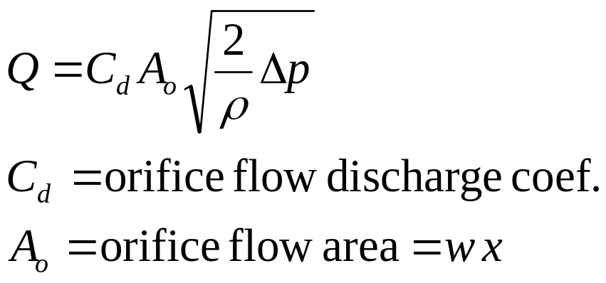
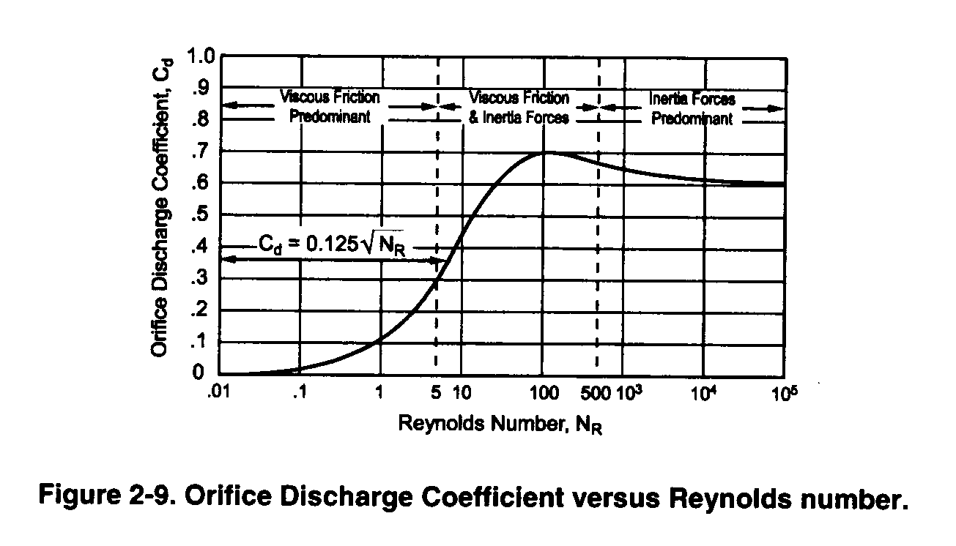
Orifice Model

Slide 14
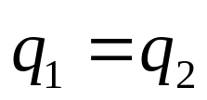
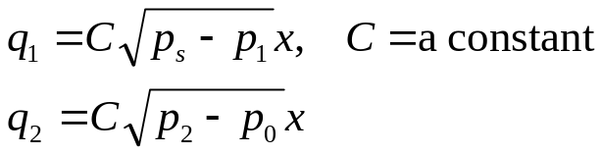

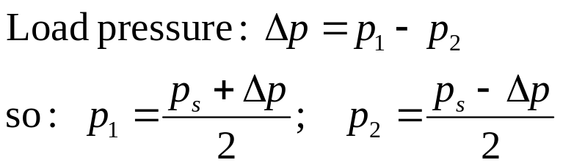
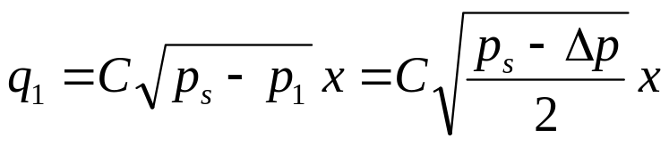
4 Way Proportional Spool Valve Model
Spool assumptions
  No leakage, equal actuator areas
  Sharp edged, steady flow
  Opening area proportional to x
  Symmetrical
  Return pressure is zero
  Zero overlap
Fluid assumptions
  Incompressible
  Mass density ρ
p₀
p_{s}
p₀
x
p₂, q₂
p₁, q₁

Slide 15
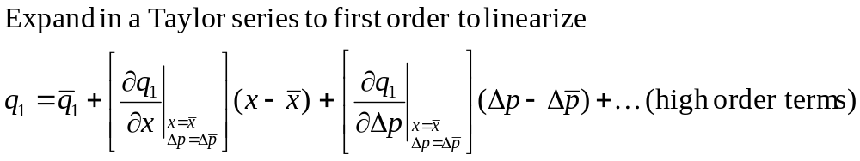
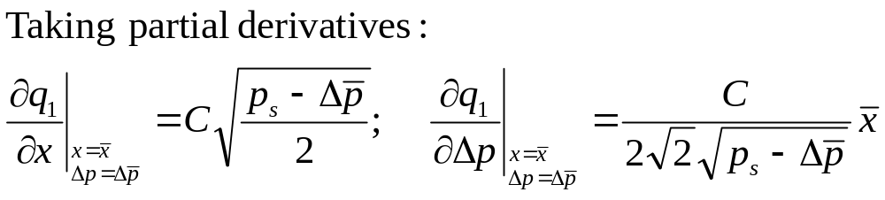
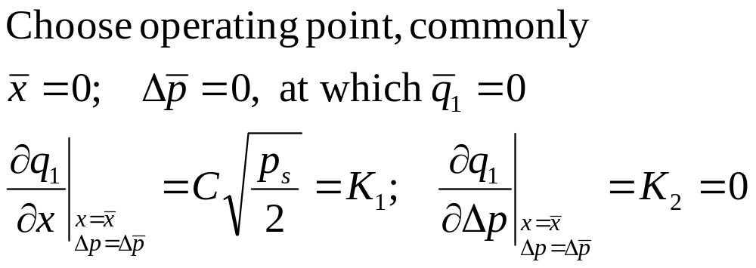
Dynamic Equations (cont.)
p₀
p_{s}
p₀
x
p₂, q₂
p₁, q₁

Slide 16

Dynamic Equations: the Actuator
q₁
Change in volume
y
Change in density
Net area A_{p}
If truly incompressible:
Specification of flow without a response in pressure brings a causality problem
For example, if the piston has mass, and flow can change instantaneously, infinite force is required for infinite acceleration
Need to account for change of density and compliance of walls of cylinder and tubes

Slide 17
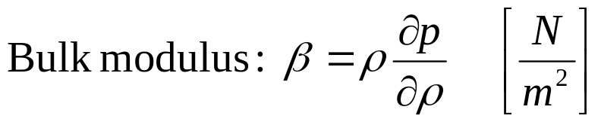
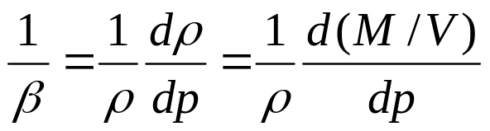
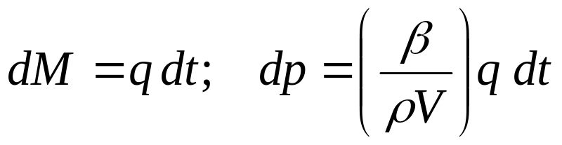
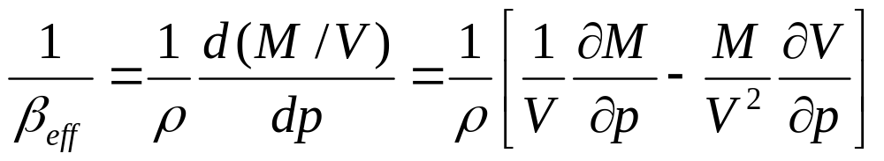
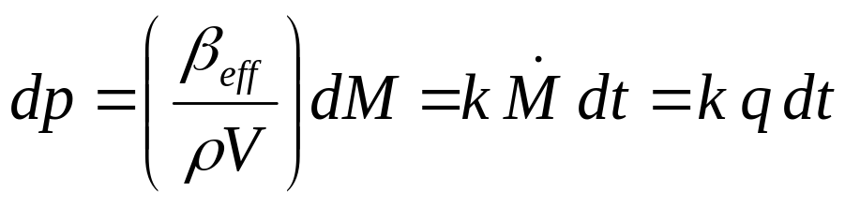
Compressibility of Fluids and Elasticity of Walls
For the pure definition, the volume is fixed.
More useful here is an effective bulk modulus that includes expansion of the walls and compression of entrapped gasses
Using this to solve for the change in pressure

Slide 18
Choices for modeling the hydraulic actuator
With no compliance or compressibility we get actuator velocity v as
q
dv/dt
1/Aρ
With compliance and/or compressibility combined into a factor k
And with moving mass m
q
p
dv/dt
k
∫ dt
A /m

Slide 19
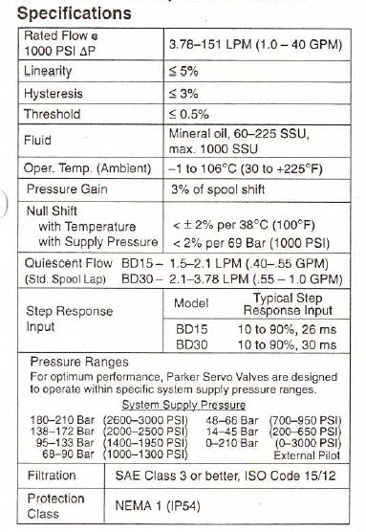
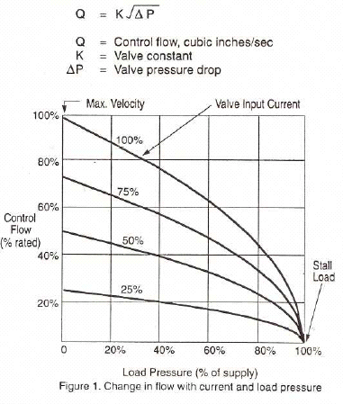
Manufacturer’s Data: BD15 Servovalve on HAL

Slide 20
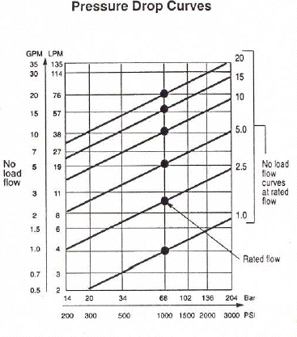
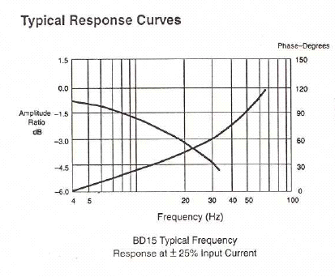
Manufacturer’s Data: BD15 Servovalve on HAL

Slide 21
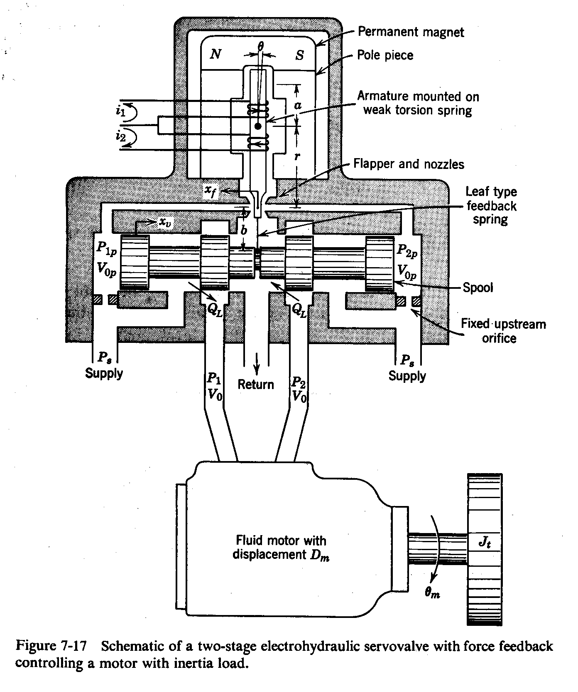
Two-stage Servo Valve
With flapper centered the flow and pressure is balanced
Torque motor rotates flapper, obstructs left nozzle
Feedback spring balances torque motor force
Pressure increases Spool is driven right
Flow gives negative rotation

Slide 22
Details of Force Feedback Design
2 Sharp edged orifices, symmetrical opening
Shown line to line; no overlap or underlap

Slide 23
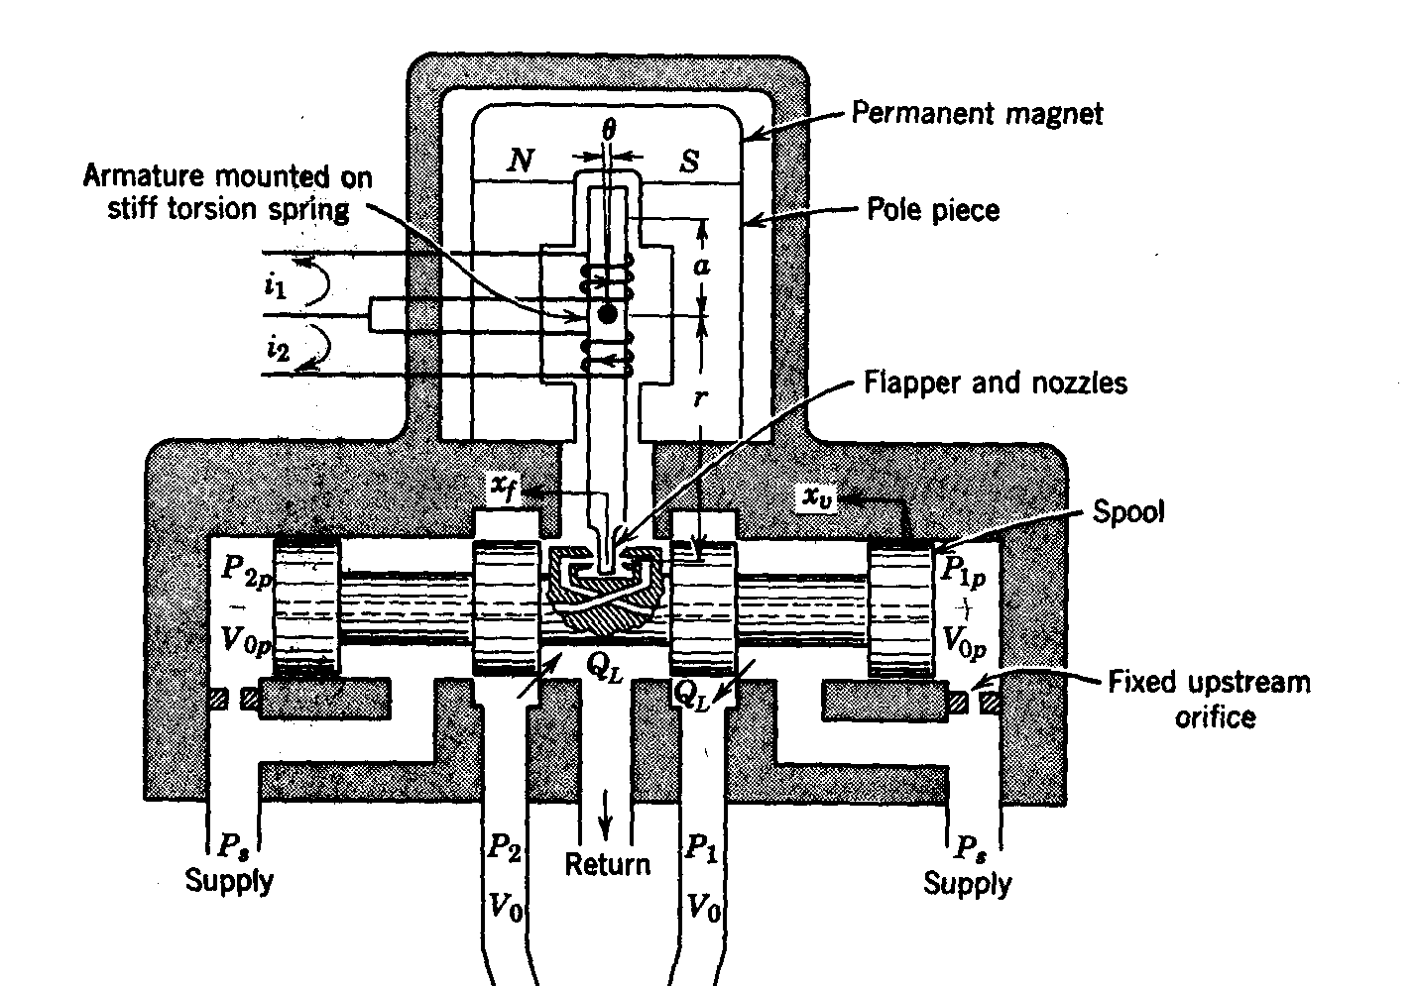
Another valve design with direct feedback

Slide 24
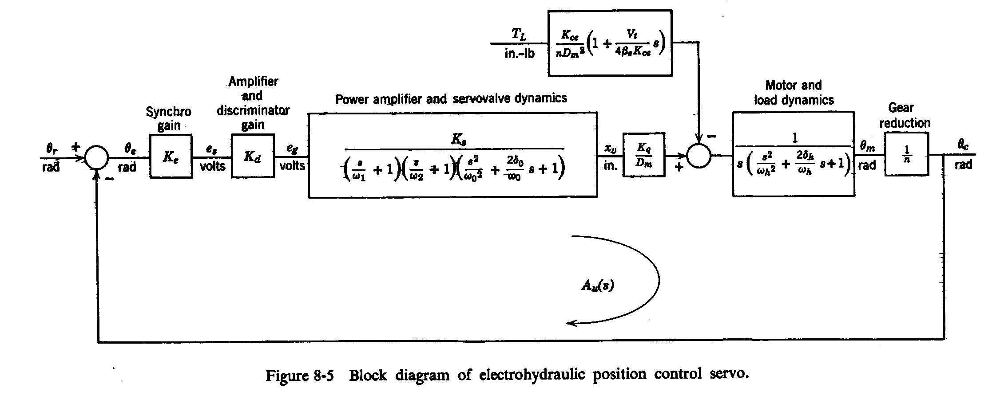
Position Servo Block Diagram
Position measurement
Flow gain / motor displacement
Load torque
Proportional control
Net flow / displacement
May be negligible

Slide 25
Design of some components
(with issues pertinent to this class)
The conduit (tubing) is subject to requirements for
  flow (pressure drop)
    2 to 4 ft/sec for suction line bulk fluid velocity
    7 to 20 ft/sec for pressure line bulk fluid velocity
  pressure (stress)
The piston-cylinder is the most common actuator
  Must withstand pressure
  Must not buckle

Slide 26
Design Equations for Fluid Power Systems
Flow
  Darcy’s formula
  Orifice flow models
Stress
  Thin-walled tubes (t<0.1D)
  Thick-walled tubes (t>0.1D)
Guidelines
  Fluid speed
  Strengths
  Factors of safety (light service: 2.5, general: 3.15, heavy: 4-5 or more)

Slide 27
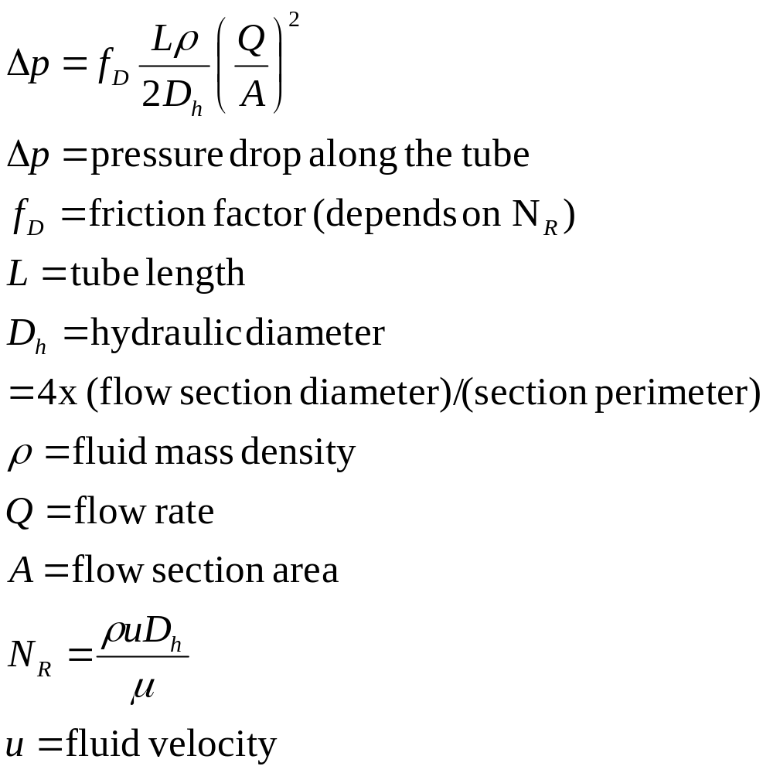
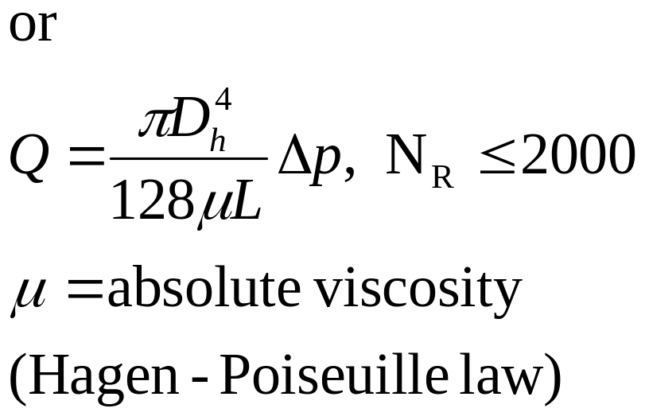
Darcy’s formula from Bernoulli’s Eq.

Slide 28
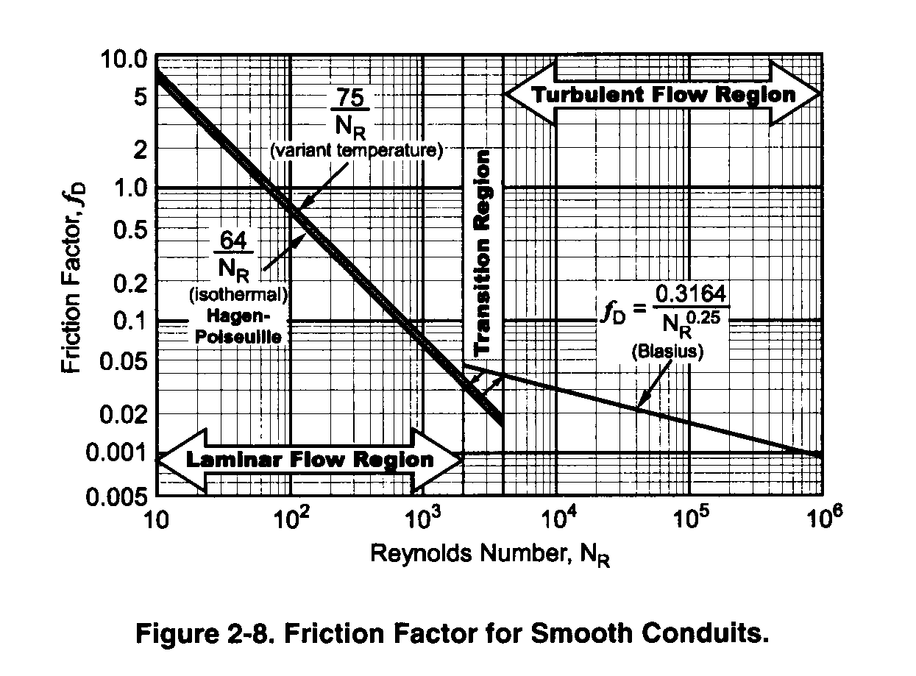
Friction factor for smooth pipes
(empirical) from e.g. Fitch

Slide 29
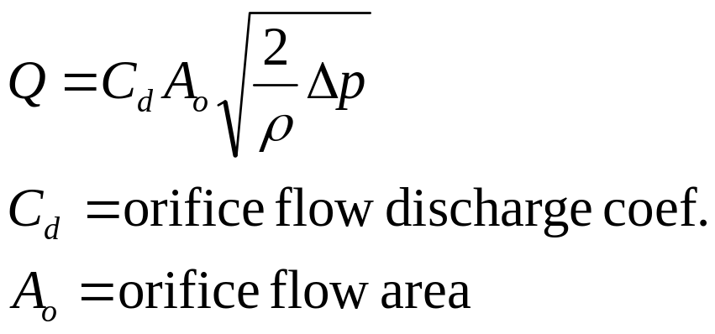
Orifice Model

Slide 30
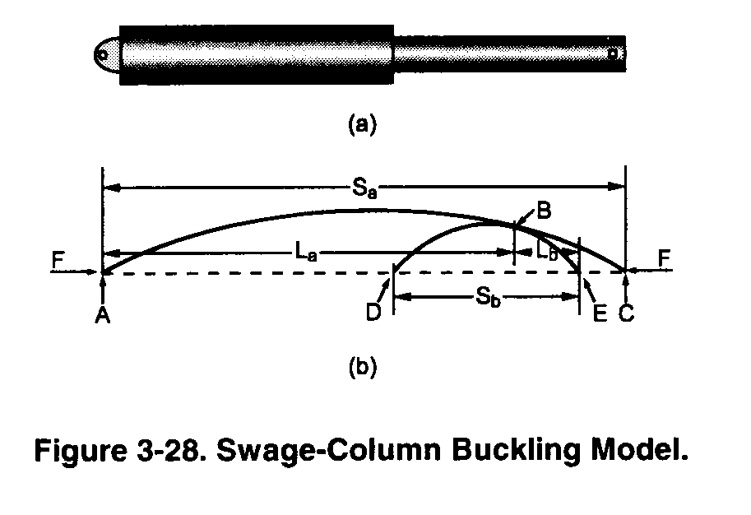
Buckling in the Piston Rod (Fitch)
Rod is constrained by cylinder at two points
Constrained by load at one point
Diameter must resist buckling
Theory of composite “swaged column” applies
Composite column fully extended is A-B-E shown below consisting of 2 segments
  A-B segment buckles as if loaded by force F on a column A-B-C
  B-E segment buckles as if loaded by F on DBE
  Require tangency at B

Slide 31
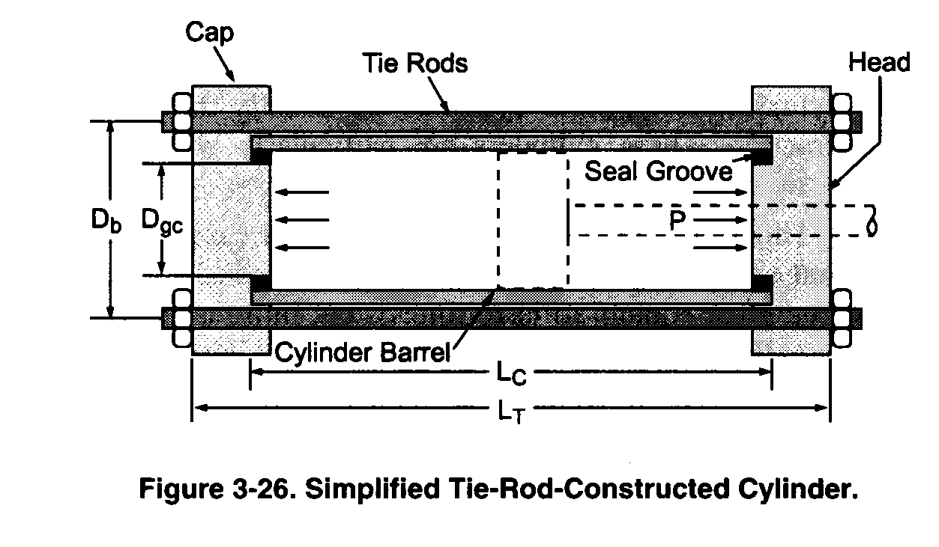
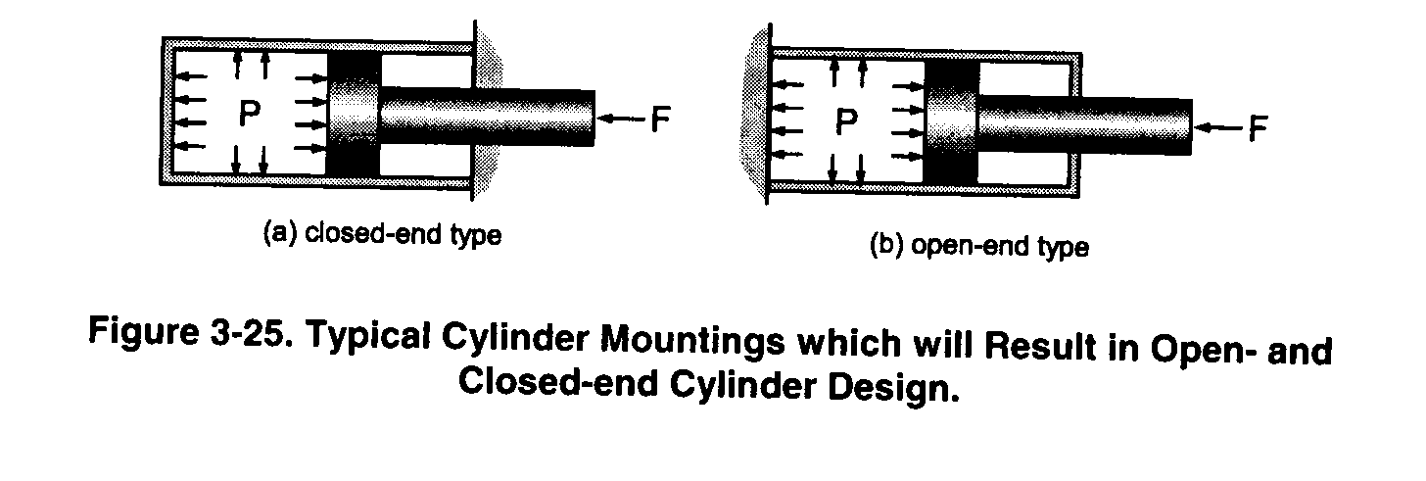
Cylinder construction (tie-rod design)
Resulting loading on cylinder walls

Slide 32
Applicable wall thickness stress formulas
(conduits or cylinders)
Thin walled cylinders (open, or where only circumferential hoop stress is significant) (Barlow)
Thick walled cylinders
  Brittle materials (based on max normal stress) use Lame’s formula
  Ductile (based on max strain theory)
    Open end (no axial stress) (Birnie)
    Closed end (cylinder bears axial stress) (Clavarino)
Expansion of cylinder based on strain = stress/(Young’s modulus)

Slide 33
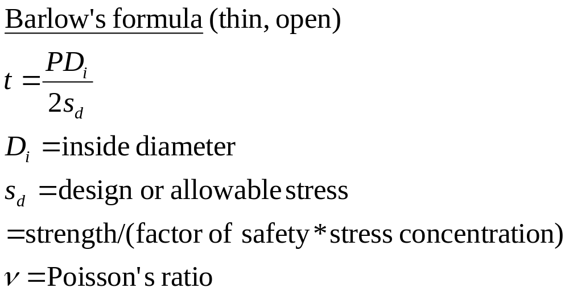
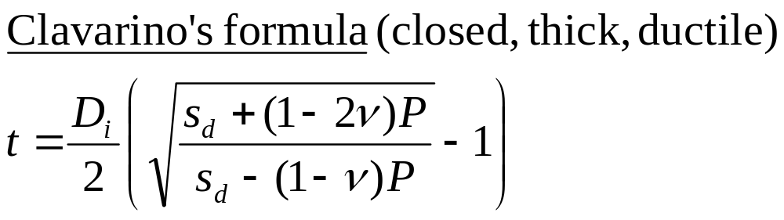
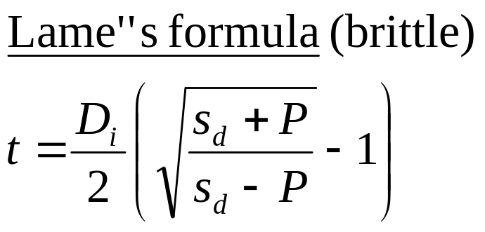
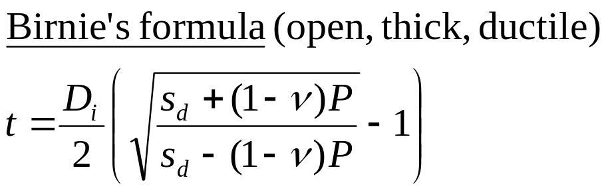
Stress formulas

Slide 34
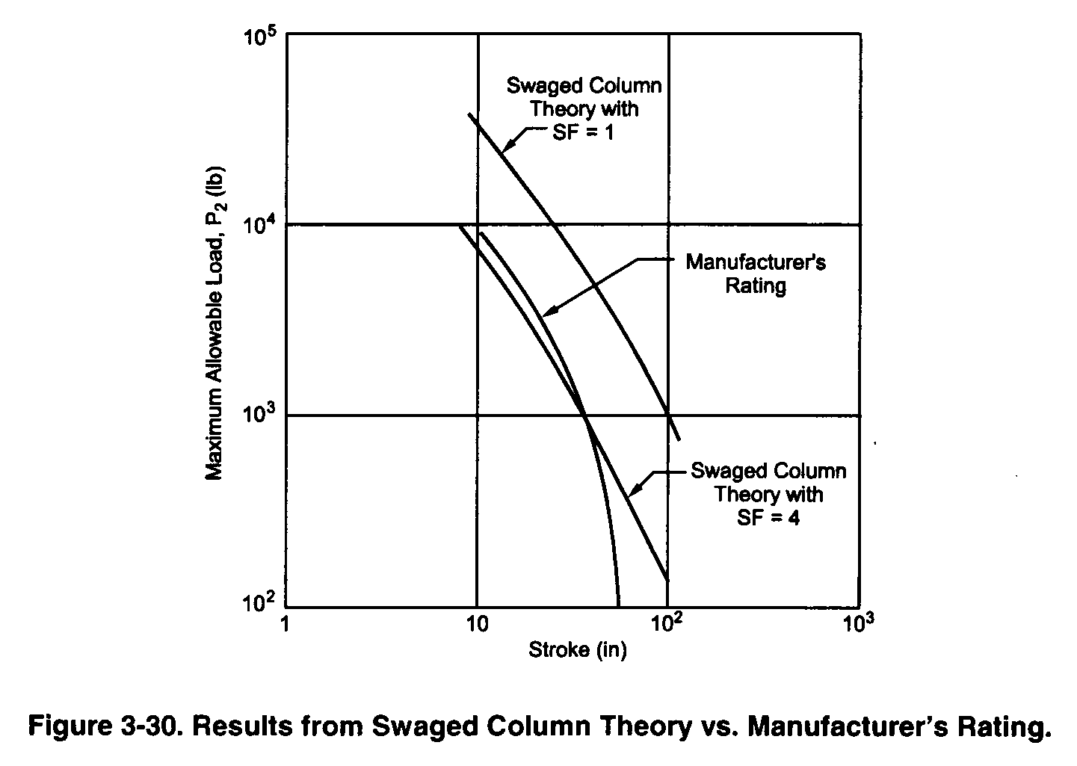
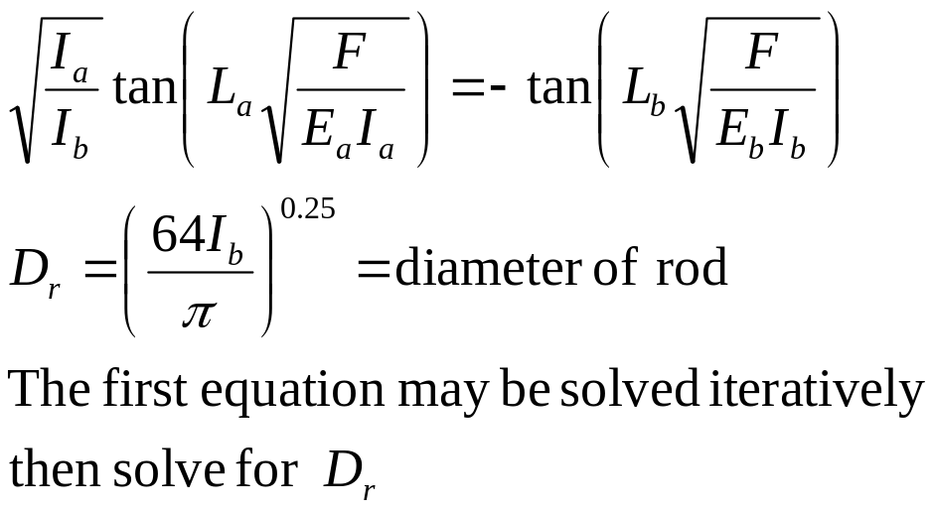
Results of Composite Column Model
Equating the slope of the two column segments at B where they join yields:
Composite column model matches manufacturer’s recommendations with factor of safety of 4

Slide 35
Pressure Specifications
Nominal pressure = expected operating
Design pressure = Nominal
Proof pressure (for test) = 2x Design
Burst pressure (expect failure) = 4x Design

Slide 36
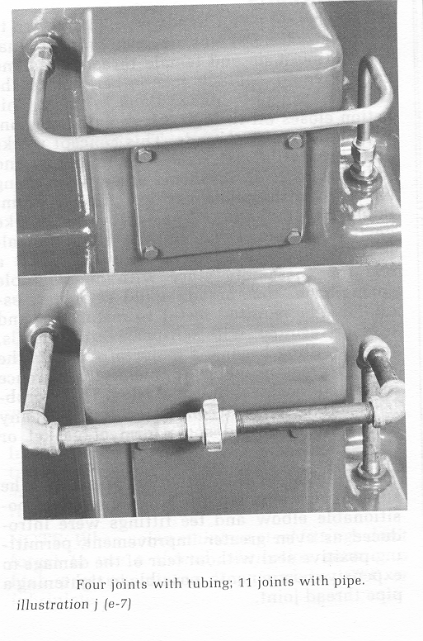
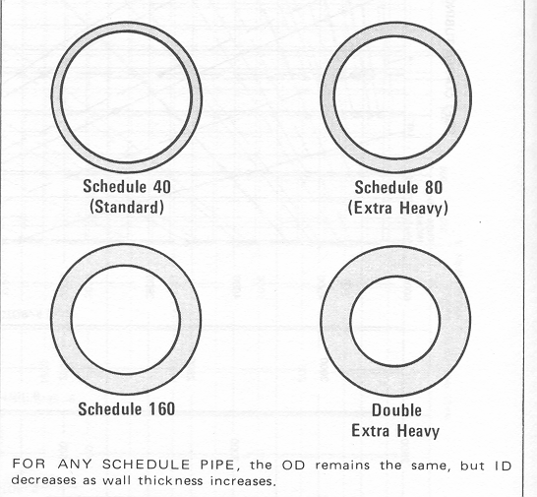
Pipes versus tubes
Tubes are preferred over pipes since fewer joints mean
Lower resistance
Less leakage
Easier construction

Slide 37
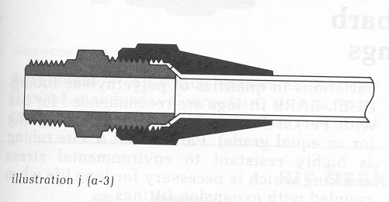
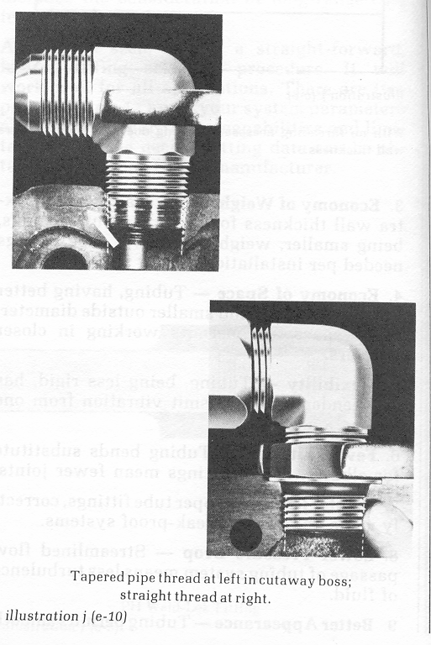
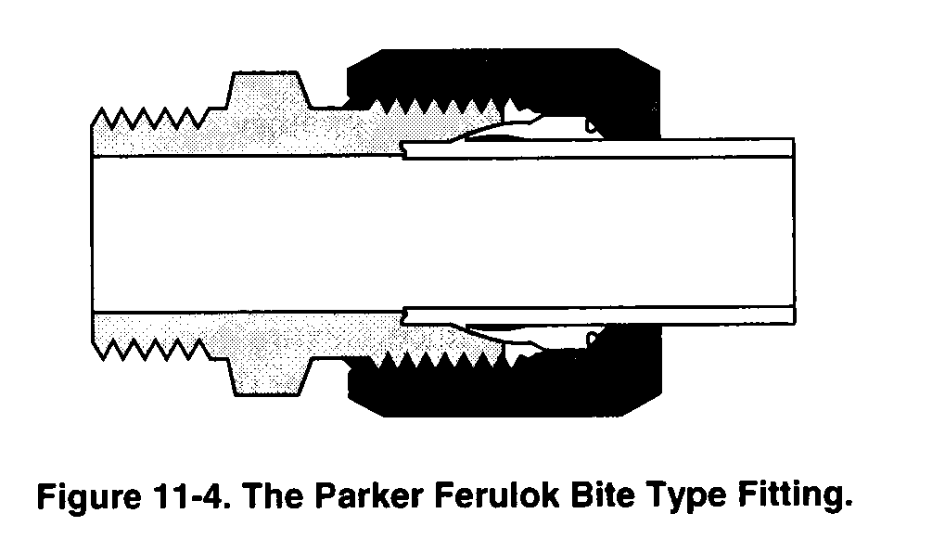
Fittings between tube and other components require multiple seals
Flared tube design

